Slide 1

Topical semantics of twitter links
Date: 2012/4/23
Source: Michael J. Welch. al(WSDM’11)
Advisor: Jia-ling, Koh
Speaker: Jiun Jia, Chiou

Slide 2
Outline
Introduction
Modeling Twitter
Analysis of the graph
Exploring link semantics
Experiment
Conclusion

Slide 3
Introduction
A rich graphical model for Twitter with multiple semantic edges.
The relationship between users and topics with respect to two types of edges.
  Follow link:
one user is reading what the other is writing.
  Retweet link:
one user reposts what another user posted.
The act of repeating a user’s post carries a stronger
indication of topical relevance.

Slide 4
Introduction
User’s dual role on Twitter:
─ content consumer,or reader interested in what other users
post.
─ content producer,or writer by publishing new posts.
  Follow link:
one user is reading what the other is writing.
─ A user follows other users
∵ He/She interested in reading the topic(s) they write
about.
─ Other users follow him/her
∵ They interested in reading the topic(s) he/she writes
about. (may differ from what he/she reads.)

Slide 5
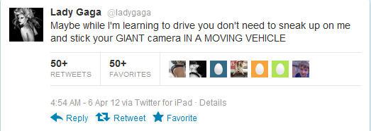
Introduction
Recent efforts to leverage this social data to rank users by quality and topical relevance have largely focused on the “follow” relationship.
Twitter’s data offers additional implicit relationships between users , however, such as “retweets” and “mentions”.
mentions: “@ username”
Retweet: “RT @ username :message”
Newer Style:
allows a user to click and generate a “retweet”
with a link to the page.
Past(old style)
retweet

Slide 6
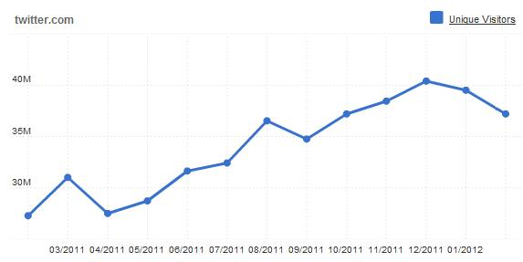
Introduction
Construct and organize a group of users referred to as a list.
Topical lists
generally centered around the discussion of common interests
or subjects. → Politics
Classification lists
generally formed to group users who share a common trait
→ Celebrities or professional athletes

Slide 7
Modeling Twitter
Full Twitter Graph
two types of entities which could be represented as nodes: users and tweets
four types of relationships between these nodes which would be represented as directional edges:
follows
publishes
user
follows
user
user
publishes
tweet

Slide 8
Modeling Twitter
retweets
mentions
tweet
retweets
tweet
tweet
mentions
user
 | User | Tweet
User | Follow | Publish
Tweet | Mention | Retweet

Slide 9
Modeling Twitter
Additional Twitter Information
There are three important pieces of information that are
not captured in this graph representation:
Time
timestamp information : each post was written as well
as when accounts were created.
Hyperlinks
standard hyperlinks embedded in the posts
augmented: third node type ( Web page[URL] )
Difficulty: common use of URL shortening services
Ex: TinyURL and bit.ly
Post Content
textual content of a post can potentially be useful
Notes:
1. There is no explicit way to determine when a follow link was created using the public API.
Time data would prove valuable for studying factors such as evolution of the graph [18] or charting popularity over time, but was omitted here for clarity and as it is not necessary for the focus of this paper.
---------------------------------------------------------------------------------------------------------------------------------------------------------------
2. A directed edge indicating a reference to the page’s URL would exist from any post pa to the “Web page node” whose URL appears in its content.
處理縮網址: Whenever link analysis for URLs is done, URL normalization would likely be required.
---------------------------------------------------------------------------------------------------------------------------------------------------------------
3. toward determining the topics of interest to a user as well
though the small size of the posts introduces several difficulties

Slide 10
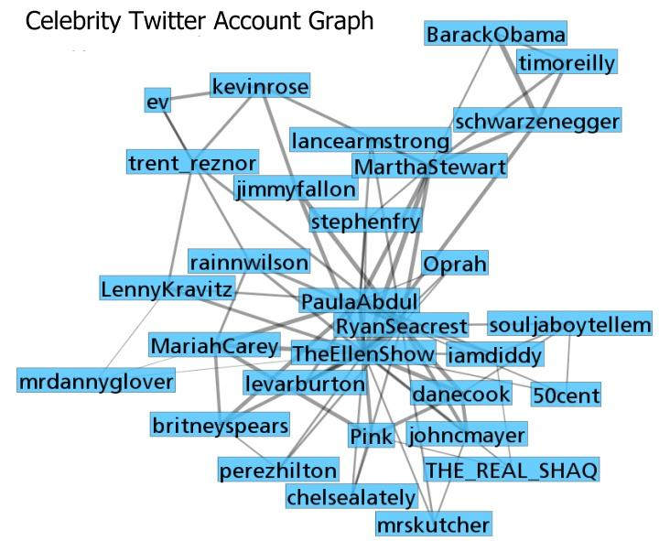
Modeling Twitter
The Simplified Twitter Graph(only include user nodes)
The user-user follow links remain as they are from the
Full Twitter graph.
Add a retweet edge from user user(a) to user(b).
Notes:
For the experiments
presented later in this paper, we use the simplified GS graph.

Slide 11
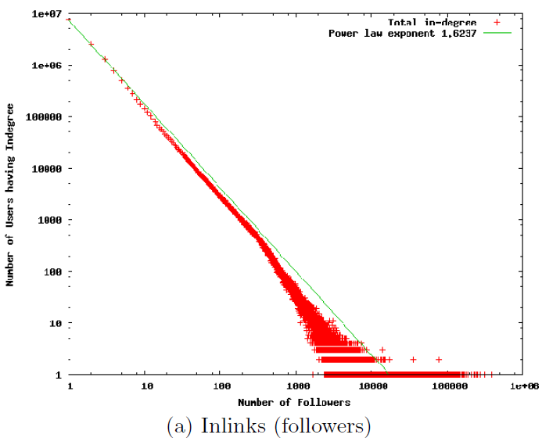
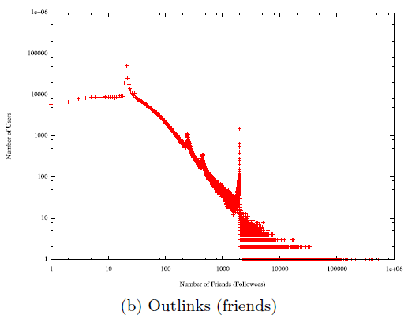
Analysis-link distribution
Follow edges
celebrities
writer
reader
celebrities
Notes:
Power-law distribution :
Figure (a):
The graph only includes users who have at least one follower, and relatively few users have over 12,000 followers.
Manual inspection of these highly followed users indicates the majority are related to professional organizations (CNN), or celebrities and public figures (Ashton Kutcher, Barack Obama).
Figure(b):
An unusually high number of users follow exactly 20 other users, which is very likely a side effect of Twitter’s account signup process, which provides an initial a set of 20 “recommended” users to follow. Another large spike appears exactly on the 2000-friend mark, which is likely due to the restrictions Twitter places on following more than 2000 users.

Slide 12
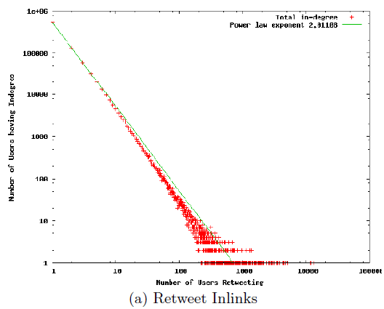
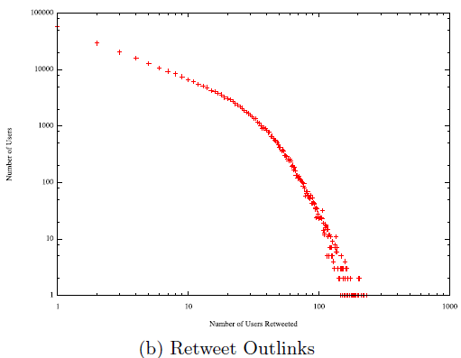
Analysis-link distribution
Retweet edges
Notes:
Figure (a):
The retweet inlinks distribution, or number of unique users who retweeted at least one post of the user.
A retweet edge is similar in nature: a link from one author to another, typically considered an indication of relevance or quality of the content, much like a hyperlink between two pages on the Web.

Slide 13
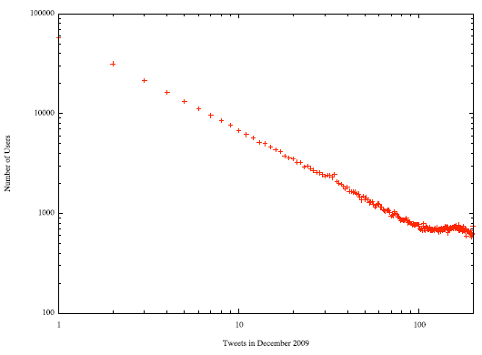
Analysis-link distribution
Posting Frequency
the number of posts published vs.
the number of users writing that many posts
Notes:
The plot shows a few interesting trends, including a large group of over 58,000 users who published only a single post during the month. It also shows a large number of users wrote more than 100 posts in the 31 day span.

Slide 14
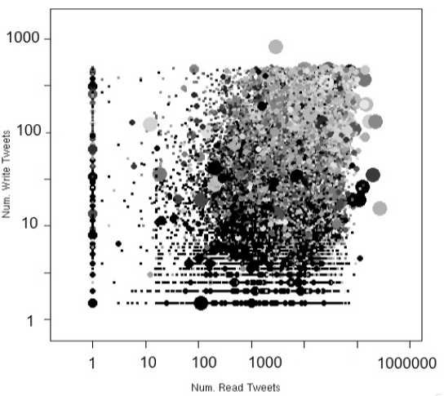
Analysis-graph formation
Overall posting behavior of a user
Possible connections between the user as a reader and the user as a writer.
(1) a user acts primarily as a reader (sink) with little or no posts
(2) a user frequently retweets posts of interest but writes little to
no original content
(3) a user contributes significant new content.
number of posts published by the user
Size:
User’s PageRank based on follow edge
Shade: originality
number of posts written by the user’s friends
Notes:
1.The size of each dot indicates the user’s PageRank based on follow-edges.
2. The shade indicates the “originality” of their posts. The lighter shades indicate less “original” content, meaning a larger percentage of the users posts are in fact retweets instead of new, original content.
3. users who post very frequently (the upper portion of the graph), a larger fraction of their posts are actually retweets.
4. many users retweeted at least one post which they did not read from one of their friends. the vertical line at x = 0 are users whose
friends collectively wrote zero posts, yet many of these users published retweets. This suggests that, despite the explicit
friendship links available in the site structure, it is still not possible to know exactly what a user reads.

Slide 15
Link Semantics
follow link on Twitter from user a to user b
─ an endorsement of quality or interest.
user a, acting as a reader, is interested in user b acting as writer.
retweet link
─ User a will retweet the posts of user b if he either is interested
in writing about the topic or expects his readers to be interested
in this post.
─ connection from user a as a writer to user b as a writer.
Reader
User a
follow
Writer
User b
Writer
User a
retweet
Writer
User b

Slide 16
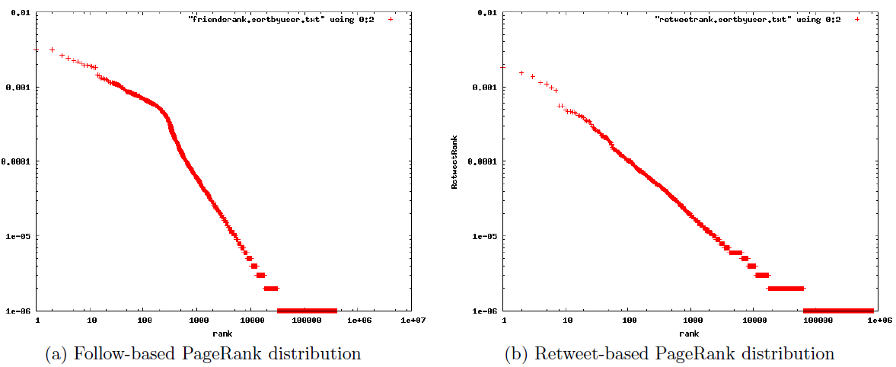
Retweet & follow based Raking
follow links -importance or “trustworthiness”.
Retweet links-topical importance or writing “interesting” posts.
14^{th rank}
7^{th rank}
Notes:
Computed PageRank over the following two sub-graphs of the simplified Twitter graph
a graph consisting of retweet links only, and a graph consisting of follow links only.
Graph:
The retweet-based ranking displays a relatively simple power-law distribution with a drop around the 7th ranked user. The follow-based ranking distribution also has a drop, around the 14th ranked user

Slide 17
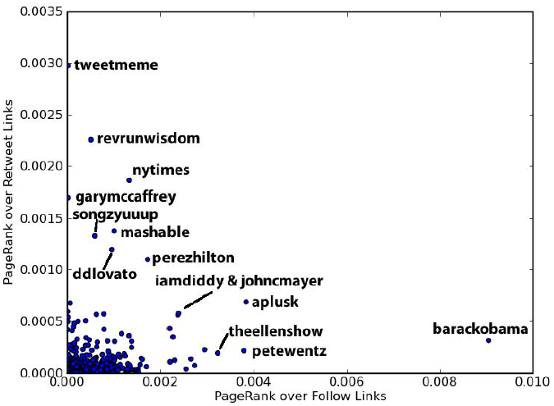
Notes:
appearance in Twitter’s recommended users list, a list that used to appear during the signup process, likely contributed. This would be another manifestation of the “rich get richer” phenomenon found on the Web . Another interesting thing to note,however, is that according to the retweet-based ranking, he is only the 33rd highest ranked user.

Slide 18
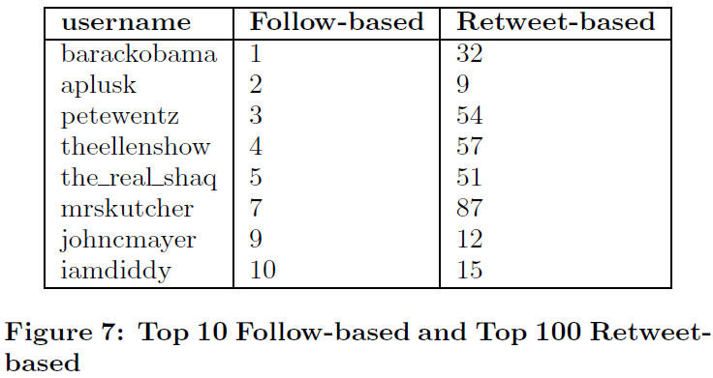
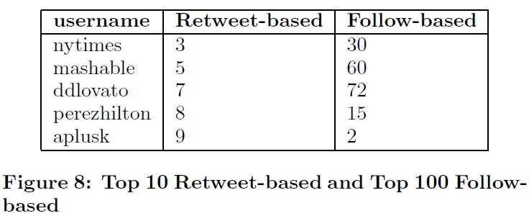
Tweetmeme: The top user according to retweet-based PageRank
follow links →the quality of a user being popular or well known.
retweet links→ the quality of being influential or producing newsworthy or topically relevant posts.
the rankings appear affected by spam or “marketing” techniques.
ddlovato(actress and singer Demi Lovato)
Notes:
Tweetmeme also allows embedding of retweet buttons on other sites, further facilitating retweeting of their posts.
This helps explain why the site is ranked number one in the retweet rankings while still being relatively low in followbased PageRank at rank 4, 610.
Spam or market:
the retweets by her followers seems to suggest at least some are in fact set up by marketers.
For example, the account ddlovatoRT states that its purpose is to simply retweet all posts mentioning Demi.

Slide 19


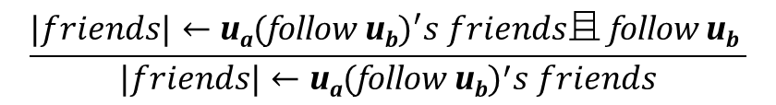
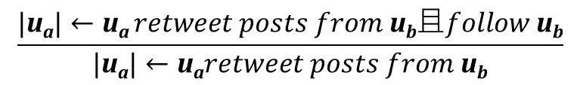
Link “Virality”
$$\frac{\text{|}\text{u}\text{a}\text{|}←\text{u}\text{a} retweet posts from \text{u}\text{b}且follow \text{u}\text{b}}{\text{|}\text{u}\text{a}\text{|}←\text{u}\text{a}retweet posts from \text{u}\text{b}}$$
RoF(u):Retweet by Friends
the users who u has seen at least one post from via a retweet.
Fr(u):
The set of users whom user u follows.
$$\frac{|friends|←\text{u}\text{a}\text{(}\text{follow} {\text{u}\text{b}\text{)}}^{′}s friends且 \text{follow} \text{u}\text{b} }{|friends|←\text{u}\text{a}\text{(}\text{follow} {\text{u}\text{b}\text{)}}^{′}s friends}$$
$\text{u}\text{a}$‘s$friends$
"u_{a"}‘s𝑓𝑟𝑖𝑒𝑛𝑑𝑠
$$\text{u}\text{a}$$
"u_{a"}
$$\text{u}\text{b}$$
"u_{b"}
FoF(u):Friends of Friends
The set of users the friends of u follow.

Slide 20
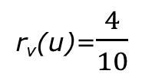
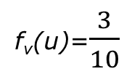
u₁
u₂
u₃
u₄
u₅
u₆
u₇
u₈
u₉
u₁₀
u₁
u₂
u₃
u₄
u₅
u₆
u₇
u₈
u₉
u₁₀
retweet
.
.
.
.
.
.
follow
u_{b}
u_{b}
r_{v}(u)=$\frac{4}{10}$
u_{a}‘s friends
follow
u_{a}
u₁,u_{2,}u_{3,}u_{4,}u_{5,}u_{6,}u_{7,}u_{8,}u_{9,}u₁₀
follow
follow
f_{v}(u)=$\frac{3}{10}$
u_{b}

Slide 21
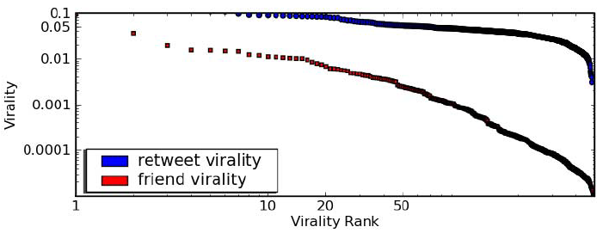
users are more likely to follow people they see retweeted
than those who are merely “Friends of Friends”.
Next:
Why follow links are less suited for determining topical relevance.
Notes:
plots the values of Retweet Virality and Follow Virality for 500 randomly selected users from our dataset.
The results show that Retweet Virality is consistently higher than Follow Virality.

Slide 22
Experiment-1
Starting from a seed set of users who are members of the same topical list.
two sets of users:
─ all users who are exactly one follow edge away from any of the
seed members (at least one seed member follows them)
─ the users who are exactly one retweet edge away from the seed
members (at least one seed member has retweeted one of
their posts).
Selected a random sample of 25 users from each of these sets and manually assessed them for topical relevance.
Experiment for two lists, one focused on “photography” and the other on “design”.
The number of relevant users in the follow-generated samples:
4 and 5
The number of relevant users in the retweet-generated samples:
19 and 20

Slide 23

Experiment-2
Manually collected 9 topical lists from listorious.com, a directory of popular lists on Twitter.
Selected the 30 highest ranking users for each graph variation.
Evaluate the relevance of these top ranked users to the original topic.(the content of their tweets, biography, username, and any external websites listed on profile.)
A total of 12 people participated in the survey. Each list was evaluated by at least 2 people.
Topics: politics, technology, economic, .……..
List size | 19~437
Average size | 155
median | 49
average followers | 14,284
Notes:
To evaluate the relevance of these top ranked users to the original topic , participants were shown a topic description along with the 30 highest ranked users for either a follow-based or a retweet-based PageRank, ordered randomly and mixed with a random set of 10 of the seed users for that topic.

Slide 24



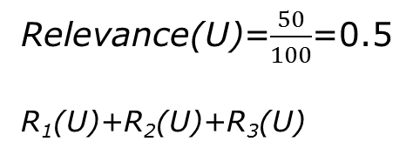
Precision of Top Ranked Users
R_{k}(U):
the set of users from U judged relevant in evaluation k of a particular list.
U: set of users
Total user:100
List 1: 10
List 2: 25
List 3: 15
7
15
5
Relevance(U)=$\frac{50}{100}$=0.5
R₁(U)+R₂(U)+R₃(U)
judged relevant
Precision(U)=($\frac{7}{10}$+$\frac{15}{25}$+$\frac{5}{15}$)/3=0.549

Slide 25
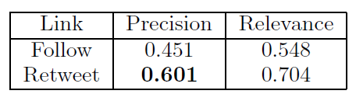
Precision and Relevance for follow links and retweet links
averaged over the 9 different topical lists
Relevant users discovered by retweet links have, on average, fewer
followers than those discovered by follows links.
The number of followers a user has is not directly related to their
relevance for a particular topic.

Slide 26
Conclusion
Twitter’s importance stems not only from its high traffic ranking, but also the amazingly rich structure it provides and realtime information it makes available.
This paper have demonstrated important distinctions between edge types in the graph, noting that the varying semantics and properties of these edges will have significant implications on graph algorithms such as PageRank.
Shown that retweet edges preserve topical relevance significantly better than follow edges.

Slide 27

Thank you
for your listening !

Slide 28


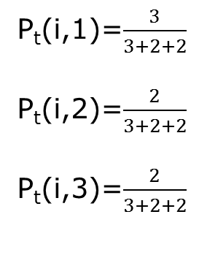
Twitter_Rank
Given topic t
Follower Si
Si’s friends
S1 S2 S3
P_{t}(i,1)=$\frac{3}{3+2+2}$
P_{t}(i,2)=$\frac{2}{3+2+2}$
P_{t}(i,3)=$\frac{2}{3+2+2}$
Tweet 1
Tweet 2
Tweet 3
Tweet 4

Slide 29
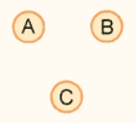
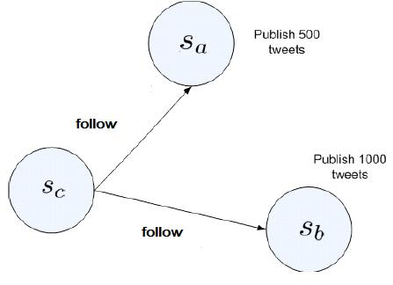
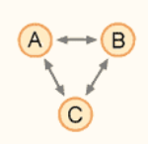
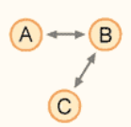

Pagerank
Sb’s influence on Sc is two times of that of Sa.

